Slide 1
Business Analysis
78 hrs

Slide 2
78hrs
S. No. | Topic | Duration (in hrs.)
1 | Business Analysis Key Concepts | 6
2 | Business Analysis Planning and Monitoring | 6
3 | Requirements Elicitation and Collaboration | 6
4 | Requirement LifeCycle Management | 6
5 | Strategy Analysis | 6
6 | Requirements Analysis and Design Definition | 15
7 | Solution Evaluation | 6
8 | Underlying Business Analyst Competencies | 6
9 | Analysis Techniques | 15
10 | Agile and Business Analysis | 6

Slide 3
Business Analysis Key Concepts

Slide 4
Learning Objectives
This topic provides an introduction to Business Analysis Key Concepts
Students completing the course would know:
The Business Analysis Key Concepts chapter includes information that provides a foundation
Business Analysis Core Concept Model
Key Terms
Requirements Classification Schema
Stakeholders:
Requirements and Designs

Slide 5
Topic Coverage
Topics
Business Analysis Core Concept Model
Key Terms
Requirements Classification Schema
Stakeholders
Requirements and Designs

Slide 6
Features of BA
BACCM
defines a conceptual framework for the business analysis profession
Key Terms
provides definitions of essential concepts which are important in BA
Requirements Classification Schema
identifies levels or types of requirements that assist the business analyst and other stakeholders in categorizing requirements
Stakeholders
defines roles, and characteristics of groups or individuals participating in or affected by the business analysis activities within a change
Requirements and Designs
describes the distinction between—and the importance of—requirements and designs as they relate to business analysis
Summary
Summaries the overall concepts of BA

Slide 7
BACCM
The six core concepts in the BACCM are:
Change,
Need,
Solution,
Stakeholder,
Value,
Context.
The BACCM can be used to:
describe the profession and domain of business analysis,
communicate about business analysis with a common terminology,
evaluate the relationships of key concepts in business analysis,
perform better business analysis by holistically evaluating the relationships among these six concepts, and
evaluate the impact of these concepts and relationships at any point during a work effort in order to establish both a foundation and a path forward.
Key Terms
Requirements Classification Schema
Stakeholders
Requirements and Designs
Summary

Slide 8
Core Concepts of BACCM
BACCM
CoreConcepts | Description
Change | The act of transformation in response to a need
Need | A problem or opportunity to be addressed.
Solution | A specific way of satisfying one or more needs in a context.
Stakeholder | A group or individual with a relationship to the change, the need, or the solution
Value | The worth, importance, or usefulness of something to a stakeholder within a context
Context | The circumstances that influence, are influenced by, and provide understanding of the change
Key Terms
Requirements Classification Schema
Stakeholders
Requirements and Designs
Summary

Slide 9
Understanding BACCM
The participants will discuss based on their understanding of BACCM and the association with the real world projects.
What is an BACCM?
How do you identify the value and context?
Examples of stakeholders?
5 min.

Slide 10
Key Terms
BACCM
Business Analysis - enabling change in an enterprise by defining needs and recommending solutions that deliver value to stakeholders.
Business Analysis Information – the broad and diverse sets of information that business analysts analyze, transform, and report.
Design - A design is a usable representation of a solution.
Enterprise - An enterprise is a system of one or more organizations and the solutions they use to pursue a shared set of common goals.
Organization - An autonomous group of people under the management of a single individual or board, that works towards common goals and objectives
Plan - Plans describe a set of events, the dependencies among the events, the expected sequence, the schedule, the results or outcomes, the materials and resources needed, and the stakeholders involved.
Requirement - A requirement is a usable representation of a need. R
Risk - Risk is the effect of uncertainty on the value of a change, a solution, or the enterprise
Key Terms
Requirements Classification Schema
Stakeholders
Requirements and Designs
Summary

Slide 11
Requirement Classification Schema
BACCM
Business requirements: statements of goals, objectives, and outcomes that describe why a change has been initiated. They can apply to the whole of an enterprise, a business area, or a specific initiative.
Stakeholder requirements: describe the needs of stakeholders that must be met in order to achieve the business requirements. They may serve as a bridge between business and solution requirements
Solution requirements: describe the capabilities and qualities of a solution that meets the stakeholder requirements. They provide the appropriate level of detail to allow for the development and implementation of the solution.
Solution requirements can be divided into two sub-categories:
Functional requirements: describe the capabilities that a solution must have in terms of the behaviour and information that the solution will manage,
Non-functional requirements or quality of service requirements: do not relate directly to the behaviour of functionality of the solution, but rather describe conditions under which a solution must remain effective or qualities that a solution must have
Key Terms
Requirements Classification Schema
Stakeholders
Requirements and Designs
Summary

Slide 12
Requirement Classification Schema
BACCM
Transition requirements:
describe the capabilities that the solution must have and the conditions the solution must meet to facilitate transition from the current state to the future state, but which are not needed once the change is complete.
They are differentiated from other requirements types because they are of a temporary nature.
Transition requirements address topics such as data conversion, training, and business continuity
Example of Requirements
Increase repeat orders from customer by 10% within six month after deployment.
View order history
Allow sorting by account opening date
Allow upto 200 concurrent users
Must run on all java platform including 64-bit versions.
Key Terms
Requirements Classification Schema
Stakeholders
Requirements and Designs
Summary

Slide 13
Stakeholders
BACCM
Business Analyst - The business analyst is responsible and accountable for the execution of the all activities.
Customer- A customer uses or may use products or services produced by the enterprise and may have contractual or moral rights that the enterprise is obliged to meet.
Domain Subject Matter Expert - A domain subject matter expert is any individual with in-depth knowledge of a topic relevant to the business need or solution scope.
End User - End users are stakeholders who directly interact with the solution. End users can
Implementation Subject Matter Expert - An implementation subject matter expert is any stakeholder who has specialized knowledge regarding the implementation of one or more solution components
Operational Support - Operational support is responsible for the day-to-day management and maintenance of a system or product.
Project Manager - Project managers are responsible for managing the work required to deliver a solution that meets a business need, and for ensuring that the project's objectives are met while balancing the project factors including scope, budget, schedule, resources, quality, and risk
Key Terms
Requirements Classification Schema
Stakeholders
Requirements and Designs
Summary

Slide 14
Stakeholders
BACCM
Regulator - Regulators are responsible for the definition and enforcement of standards. Standards can be imposed on the solution by regulators through legislation, corporate governance standards, audit standards, or standards defined by organizational centers of competency.
Sponsor - Sponsors are responsible for initiating the effort to define a business need and develop a solution that meets that need.
Supplier - A supplier is a stakeholder outside the boundary of a given organization or organizational unit.
Tester - Testers are responsible for determining how to verify that the solution meets the requirements defined by the business analyst, as well as conducting the verification process.
Key Terms
Requirements Classification Schema
Stakeholders
Requirements and Designs
Summary

Slide 15
Requirement and Design
BACCM
Eliciting, analyzing, validating, and managing requirements have consistently been recognized as key activities of business analysis.
Requirements are focused on the need; designs are focused on the solution
A requirement (or set of requirements) may be used to define a design. That design may then be used to elicit additional requirements that are used to define more detailed designs. The business analyst may hand off requirements and designs to other stakeholders who may further elaborate on the designs. Whether it is the business analyst or some other role that completes the designs, the business analyst often reviews the final designs to ensure that they align with the requirements.
Key Terms
Requirements Classification Schema
Stakeholders
Requirements and Designs
Summary

Slide 16
BACCM
Refer the Hint for the requirement and Design
Requirement | Design
View six months sales data across multiple organizational units in a single view | A sketch of a dashboard
Reduce amount of time required to pick and pack a customer order | Process Model
Record and access a medical patient’s history. | Screen mock-up showing specific data fields.
Develop business strategy, goals, and objectives for a new business | Business Capability Model.
Provide information in English and French. | Prototype with text displayed in English and French.
Key Terms
Requirements Classification Schema
Stakeholders
Requirements and Designs
Summary

Slide 17
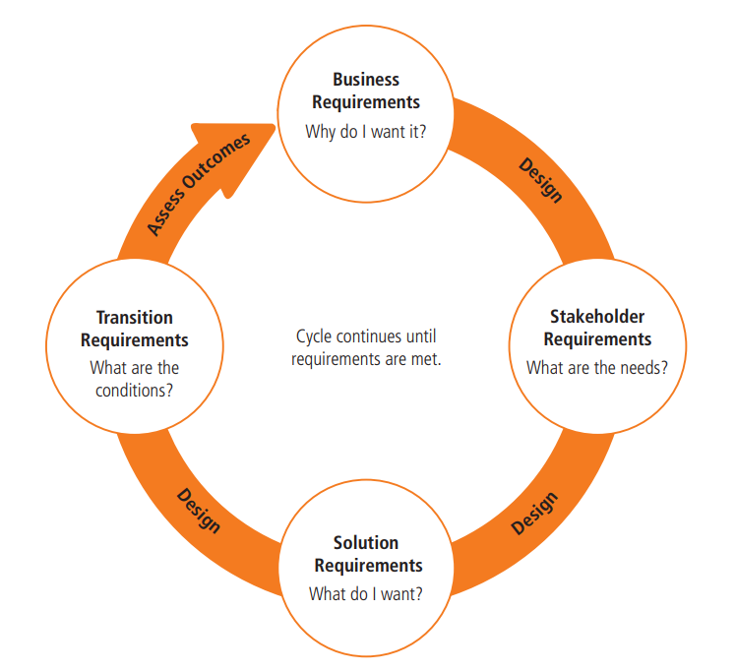
Requirement and Design Cycle
BACCM
Key Terms
Requirements Classification Schema
Stakeholders
Requirements and Designs
Summary

Slide 18
Summary
BACCM
Understood the various Business Analysis Key Concepts;
BACCM
Key Terms
Requirement Classification
Stakeholder roles and responsibilities
Requirements and Design
Key Terms
Requirements Classification Schema
Stakeholders
Requirements and Designs
Summary

Slide 19
Multiple Choice Questions
_________is an act of transformation within an organization in response to a need. ?
A ________ is a wide-ranging term that can include everything from an organization’s culture, mission, and demographics to government policies, competitors, products and sales
a) Change
a) Change
b) Need
b) context
c) Solution
c) Value
d) All of the above
d) Solution
Notes:
Q1: d | Q2: a

Slide 20
Multiple Choice Questions
A _________is a usable representation of a solution.
___________focus on understanding what kind of value could be delivered if a requirement is fulfilled.
a) Design
a) Both are correct
b) Requirement
b) Solution
c) Problem Statement
c) Requirements
d) Stakeholder
d) None is correct
Notes:
Q3: a | Q4: a

Slide 21
Multiple Choice Questions
_______ describe the capabilities and qualities of a solution that meets the stakeholder requirements
________describe the capabilities that the solution must have and the conditions the solution must meet to facilitate transition from the current state to the future state, but which are not needed once the change is complete.
a) Transition Requirement
a) Business Requirement
b) Business Requirement
b) Transition requirements
c) All Mentioned
c) none
d) Solution requirements
d) both
Notes:
Q5: c | Q6: a

Slide 22
Multiple Choice Questions
A ________uses or may use products or services produced by the enterprise
______are responsible for initiating the effort to define a business need and develop a solution that meets that need.
a) Domain SME
a) End User
b) End User
b) Sponsors
c) customer
c) Customer
d) Sponsor
d) SME
Notes:
Q7: b | Q8: b

Slide 23
Multiple Choice Questions
Which design Model used for Reduce amount of time required to pick and pack a customer order
designs are focused on the________
a) Screen mock-up showing specific data fields.
a) interest
b) Process Model
b) User need
c) Sketch Model
c) Requirement
d) Prototype
d) solution
Notes:
Q9: a | Q10: b

Slide 24
Re-Cap
The participants will discuss their knowledge on Business Analysis Concepts based on the session, and clarify their doubts. One of the scholars could be the facilitator along with the trainer.
Why BA is required?
What is the happen when the requirement is not understand properly starting the project?
What are different types of Requirement?
How design is differ from the requirement?
What are the roles and responsibilities of stakeholders?
10 min.

Slide 25
Next Session Details
Preparation for the next session
We would be learning the topic mentioned below
Business Analysis Planning and Monitoring
Pre-requisite: Learn about types of requirement and importance of planning.

Slide 26
Cue Card for Assimilation Check
Question Number | Correct Answer | Slide Number
1 | a | Slide 7 (BACCM)
2 | b | Slide 8 (BACCM)
3 | a | Slide 10 (Key Terms)
4 | c | Slide 10 (Key Terms)
5 | d | Slide 11 (Requirements)
6 | b | Slide 12 (Requirements)
7 | c | Slide 13 (Stakeholder)
8 | b | Slide 14 (Stakeholder)
9 | b | Slide 15 (Polymorphism)
10 | d | Slide 16 (Inheritance)

Slide 27
References
50 Examples of Business Requirements – Simplicable
The Quest for Good Requirements - Business Analyst Articles, Webinars, Templates, Jobs (batimes.com)
How to Organize Requirements as a Business Analyst (guru99.com)

